Slide 1




Communication & Visibility
December 3, 2020

Slide 2

COMMUNICATION STRATEGY / OBJECTIVES
Supporting the implementation of activities
Supporting the regional platform
Visibility of the Programme
Contributing to new policies and reforms by:
Disseminating knowledge
Sharing tools
Raising technical awareness
Online training, coaching and mentoring
Supporting SBACs through visibility
Chat rooms to engage national stakeholders into dialogue
Experience / practices sharing
Repository of non-proprietary knowledge
Alert on regional opportunities
Awareness on EU new strategies
Awareness on main activities and results
Coordination with other EU Programmes
Articles, social media, website and videos…

Slide 3
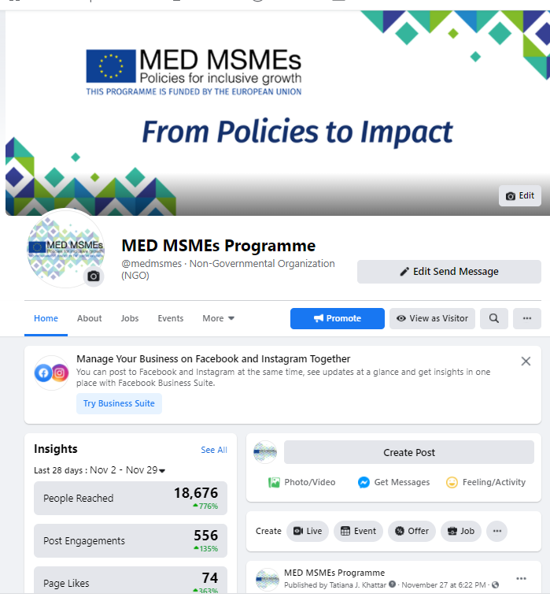
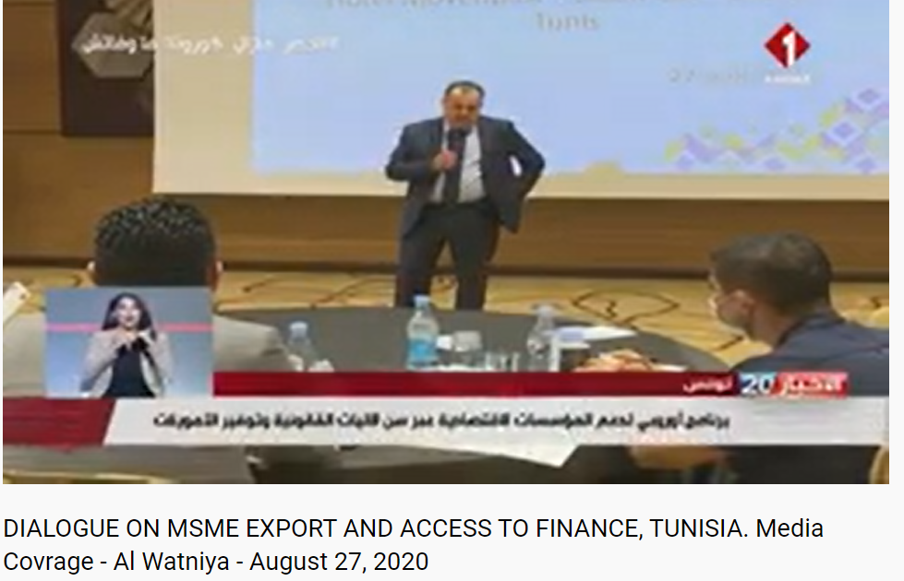
ACTIVITIES
Social Media
Since September 2020 the Programme regularly posted on Facebook and Linkedin, reaching 55,000+ recipients and generating post-engagement (2,500) and followers (1,500)
www.facebook.com/medmsmes
YouTube MED MSMEs Programme
https://www.linkedin.com/company/medmsmesprog
Event Coverage
All events and working groups are communicated on social media on the same day, and through other media when physical events are possible (television, print)

Slide 4
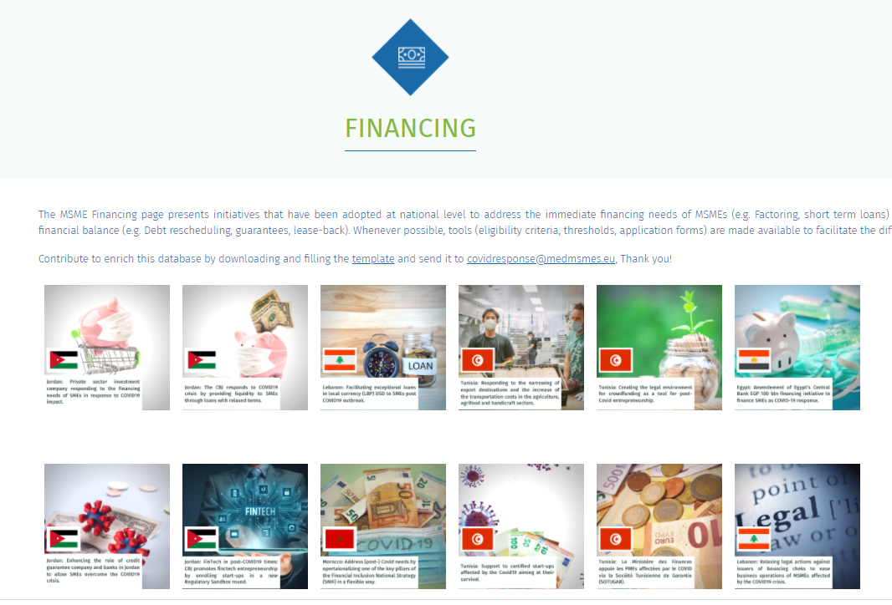
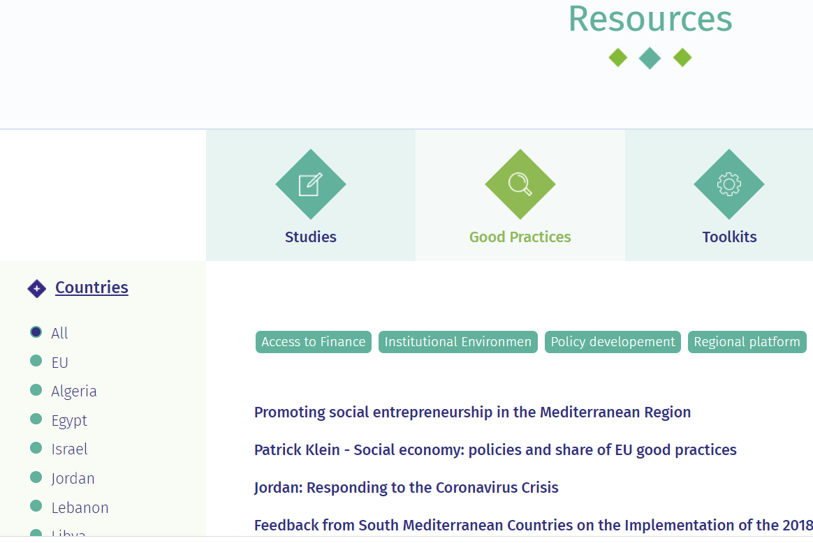
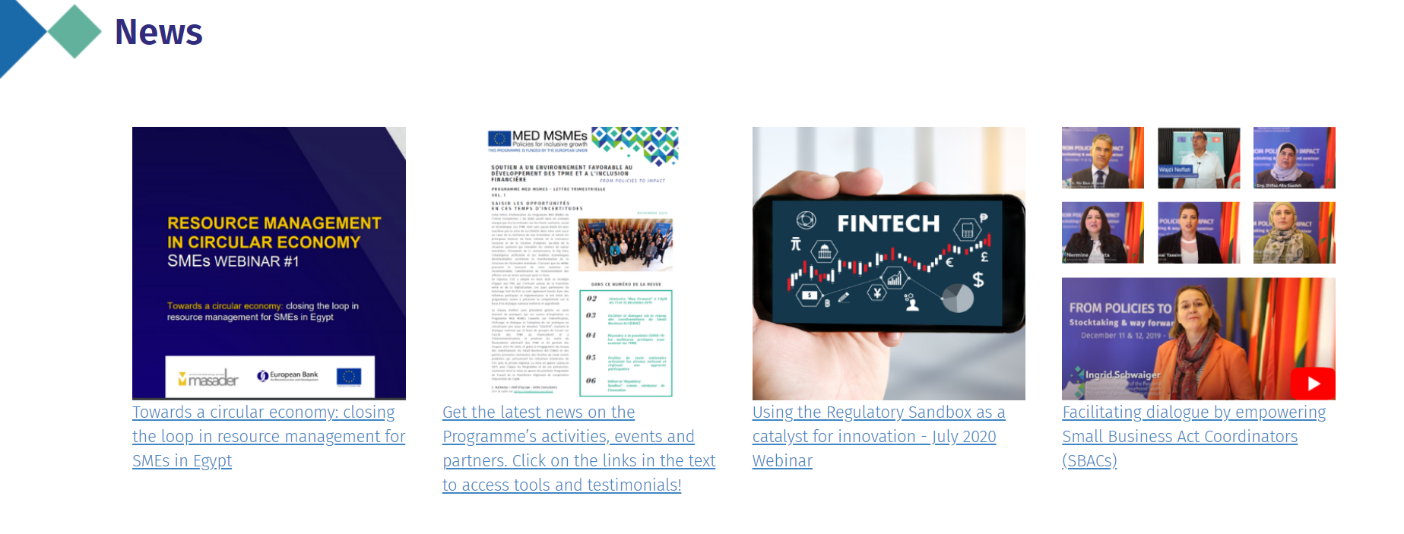
ACTIVITIES
Website
Website launched in September 2020 and being updated to become increasingly interactive in the presentation and sharing of content including Resources, news and events, opportunities and a dialogue tool (chatbox)
https://medmsmes.eu/

Slide 5
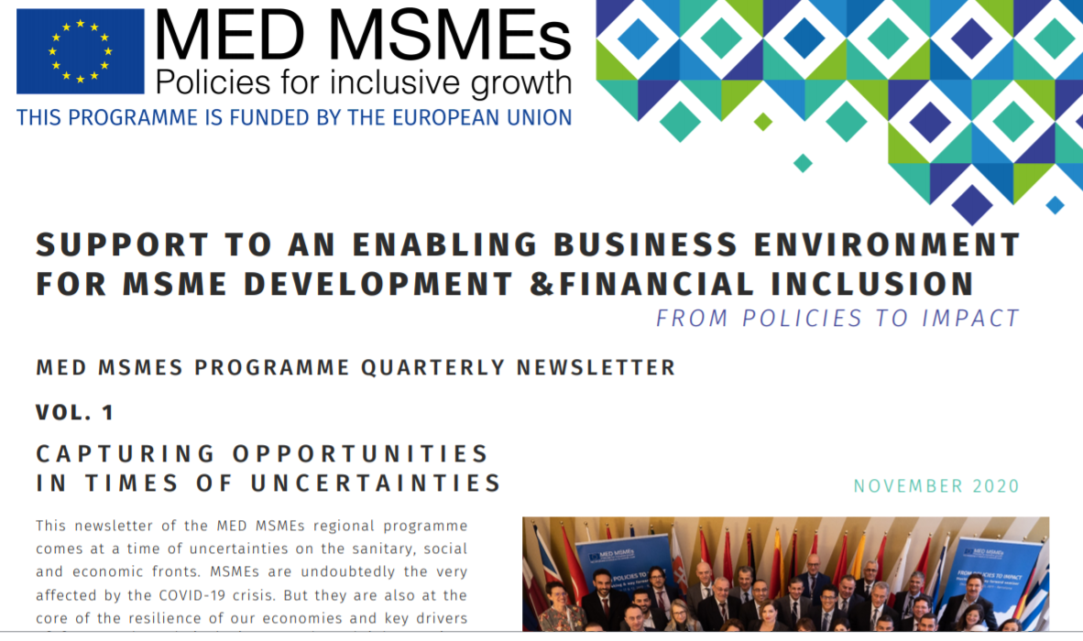
ACTIVITIES
Quarterly Newsletter
First quarterly newsletter launched in November 2020 and will be issued every quarter going forward
Case Studies
The Programme continuously shares case studies (currently through social media and the website) such as for example the crowdfunding law in Tunisia, and will in the next months begin producing videos that can provide guidance and advise based on such case studies

