Slide 1




Key Findings
and
Discussion of 2021 Orientations
December 3, 2020

Slide 2

IMPLEMENTATION 2020

Slide 3

Reminder: Key results
RESULT 2
Enhancing institutional environment
Fintech through sandbox / Risk mitigation tool
RESULT 1
SMEs as drivers of inclusive growth
Mapping of policies including COVID responses
RESULT 3
Facilitating access to alternative finance
Scaling up alternative FIs
Inspiring and supporting policy and regulatory reform
RESULT 5
Communication and Visibility
Supporting the activities and platform
RESULT 4
Supporting the Regional Platform
SBACs Capacities
Mid-term conference

Slide 4
AWP1 in the mirror
AWP 1 Key strategic objectives…
Creating communities of practice around the SBACs
Rolling out a methodology articulating the nat. / reg. levels
Identifying national priorities & positioning value adding interventions
Contextualizing in real time
Integrating the Covid response in all activities
Sustaining momentum by animating online communities
Discussing new subjects linked to economic transformation
Objective of the session: to discuss 2021 interventions based on strategic and technical / regional & national inputs

Slide 5
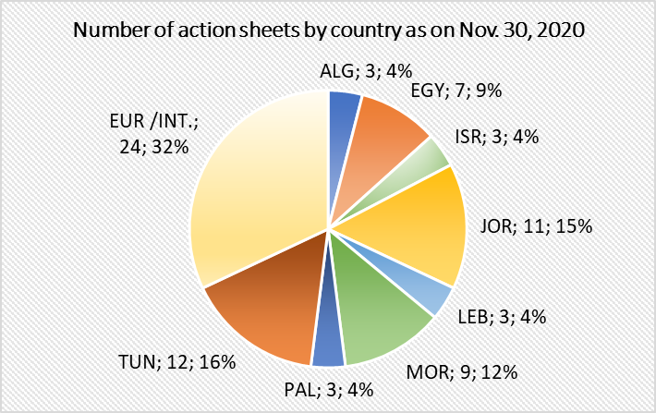
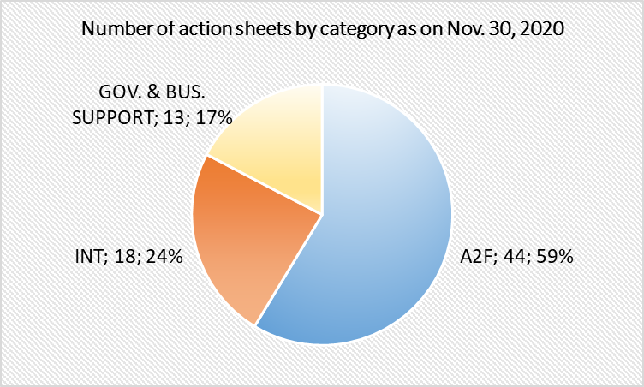
Result 1
Country outlooks and national roadmaps on Int. and A2F
Regional roadmaps based on the country roadmaps
Covid exemplary policy-in-action responses
kjhkjh 13 WG meetings / 6 countries / 330+ PP reps
8 country outlooks / 7 export EU-policy papers
40 recommendations / 75 action sheets / 100+ tools

Slide 6



Result 2
Enhancing the institutional environment, particularly A2F
Facilitating the MSME-regulatory reform process
Benchmarking of EU SB / Mobilisation of Central Banks
Experience sharing with start-ups / Tool: Guide “how to SB?”
Benchmarking study on EU counter-guarantee funds
Coordination with the EMGN and its members

Slide 7
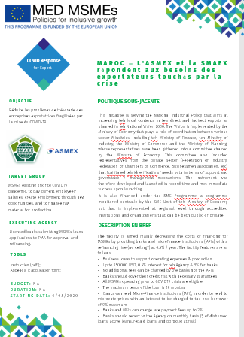
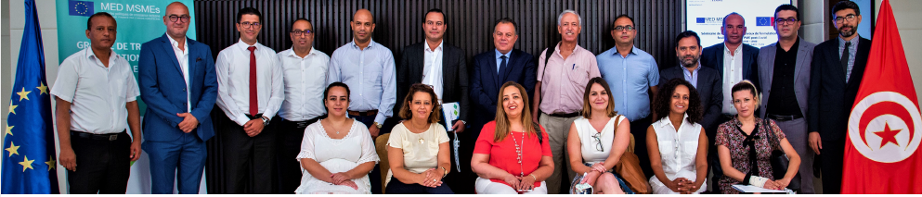
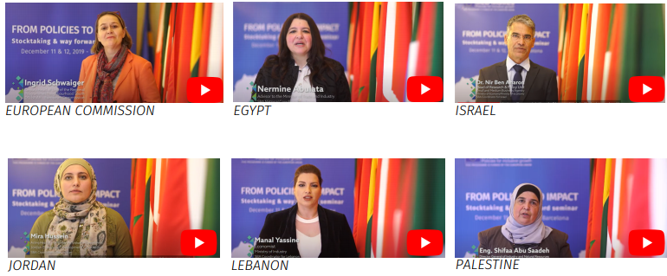
Result 4
Building-up the capacities of the SBA Coordinators
Organizing the mid-Term conference
Tools disseminated (AS, criteria analysis, roadmaps)
TAT enhancing convening power of SBACs
8 SBAC videos developed / Business cases videos
Mobilization of SBA TA for support at technical level

Slide 8
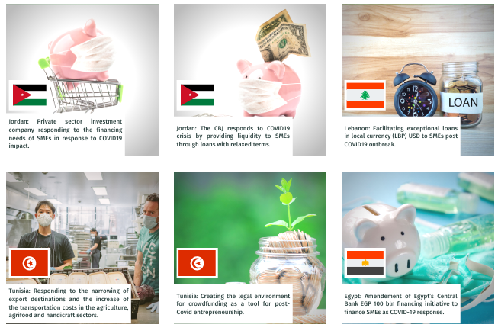
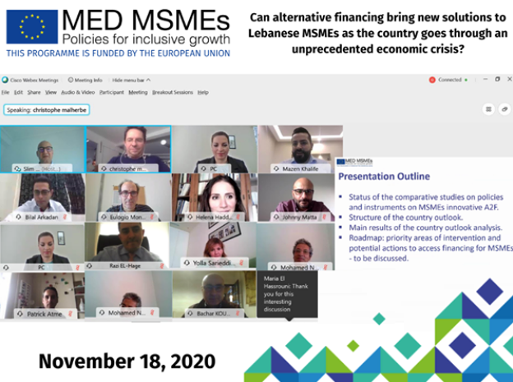
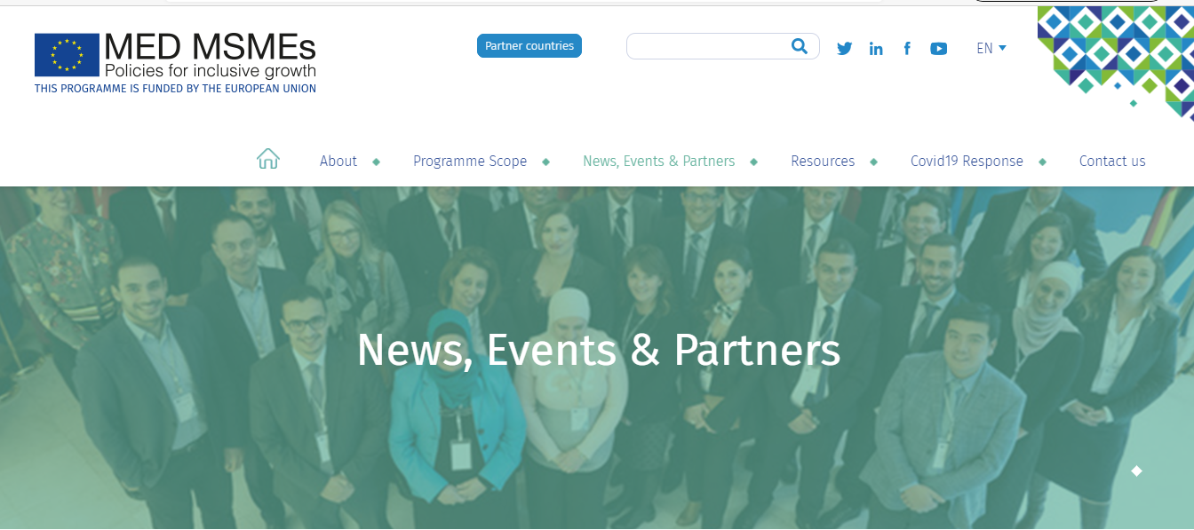
Result 5
Communication strategy serving the regional platform
Knowledge / opportunity sharing
Exchange platform for members
SBACs convening power and showcasing WG work
Print and Video material production
Social media presence (55k+) / selected target groups
Special COVID response web page
Collaborative efforts to enrich the platform

Slide 9
FINDINGS
&
LESSONS

Slide 10

New context
The pandemic is an accelerator of pre-existing trends:
Digitalisation / Big data / Alternative inclusive finance for impact
Disintermediation / Integration of SMEs in supply chains
But also created new strategic needs:
Reshoring and nearshoring: new opportunities
Lowering dependence to far imports, esp. in strategic sectors
And created a greater convergence towards:
The urgency to create more resilient economies
Decoupling growth from resource consumption
Embedding the circular economy principles

Slide 11


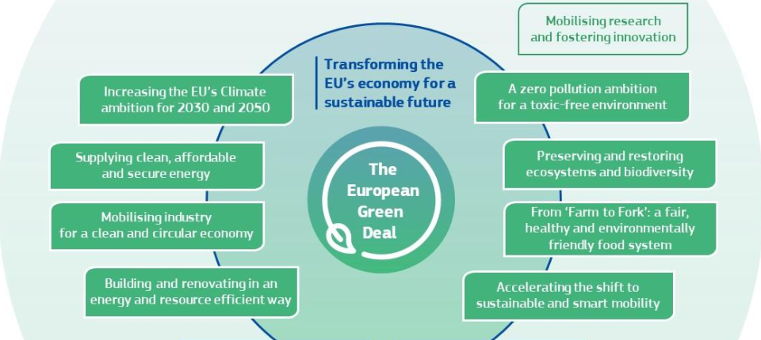
The EU response
The new SME Strategy
The new Industrial Strategy
Better serving people’s needs, creating better resilience and securing competitiveness
The EU Green Deal

Slide 12
Key findings from WGs
SMEs and digitalization top the priority agendas
Internationalisation and alternative finance “confirmed”
National dialogue and governance are more inclusive
Adoption policies, strategies and regulations is expedited
EU nearshoring trends are raising genuine interests
Africa is a growth market raising attention, but…

Slide 13
SUGGESTED ACTIVITIES

Slide 14

EU strategies
EU national Action Plans
National responses
Outcomes of national dialogue
Lessons learnt
Capturing opportunities stemming from transformations
New activities
Fostering financial inclusion through alternative finance bearing impact
Activities 2020 (cont.)
Finalizing nat. & reg. roadmaps
Covid paper / database
Completing sandbox & guarantee assignments
Mid-Term conference in April (if possible)
Keeping on supporting the regional platform
Leveraging digital tech
to capture new opportunities
Taking advantage of changes in Global Value Chains and emerging markets
Facilitating access to inclusive / alternative finance for impact
Leveraging digital tech to unleash the AF potential

Slide 15
Sub Obj. 1 Leveraging digital tech to capture new SME internationalization opportunities
Specific objectives
Knowledge on digital tools for SME exports for reform is transferred
Issues impeding the development of digital ecosystems are better addressed (notably regulatory)
1.1 Awareness on good practices of digital services to accompany SME internationalisation
1.2 Identifying bottlenecks and improving the digital ecosystem for SMEs internationalisation
1.3 Sharing experiences of digitisation of SME international trade in the Southern Neighbourhood

Slide 16
Sub. Obj. 2 Taking advantage of changes in Global Value Chains and emerging markets
Specific objectives
Awareness raised on opportunities created by the EU Industrial strategy
Awareness raised on opportunities created by the EU Green Deal
Awareness raised on African market existing supports
2.1 Raising awareness of the SME business opportunities stemming
from the new EU industrial policy
2.2 Raising awareness of the SME business opportunities linked to the post COVID reorganisation of Global Value Chains (linked to the Green Deal and digitalisation in particular)
2.3 Improving knowledge of existing schemes to develop SME business with Sub Saharan African market

Slide 17
Sub Obj. 1 Supporting the development of alternative finance for impact (inclusion)
Objectives
Facilitating access to funding for and from alternative finance suppliers
Better addressing the missing middle segment needs
Supporting alternative financing institutions stepping up their activities
1.1 Dissemination of standards and processes for raising
concessional resources for alternative finance for impact
1.2 Supporting MFIs to scale-up their lending towards
Small enterprises (“missing middle”)
1.3 Capacity building and matchmaking of financing institutions integrating women-, social, circular or green enterprises
in their target groups

Slide 18
Sub Obj. 2 Leveraging digital transformation to unleash access to alternative finance
Objectives
Contributing to the transformation of the regulatory framework for digital finance and financial services
Increasing the reach and efficiency of the digital finance ecosystems
Fostering the emergence of national fintech ecosystems
2.1 Awareness raising on the EU PSD2 as a catalyst for jobs and A2F
2.2 Addressing regulatory barriers to the development of the ecosystems of sustainable finance platforms (e.g. crowdfunding, equity)
2.3 Support to the implementation of the regulatory sandbox

Slide 19
KEY 2021 STRATEGIC STATEMENTS
BEING MORE COMPETITIVE AND INCLUSIVE THROUGH DIGITALISATION
CAPTURING OPPORTUNITIES STEMMING FROM TRANSFORMATION
FINANCIAL INCLUSION THROUGH DIGITAL ALTERNATIVE FINANCE
IMPACT AT THE CORE OF ALTERNATIVE FINANCE DEVELOPMENT

Slide 20
THANK YOU!
MERCI!
شكراً لكم

